Slide 1
Technology Safety Series: Abuse Using Technology
By Florence vicil
As a courtesy to domestic violence victim advocates in florida

Slide 2
Florence’s Bio
Former Orlando PD officer
Guardian ad Litem, Osceola County
Computer Programmer, B.S., M.S.
Member, Code for Orlando, Code for America Brigade
http://www.codefororlando.com/
http://staysafeorlando.com/
Member, STEADI [Sex Traffic/Exploitation/Abuse Dismantling Initiative]
https://www.meetup.com/STEADI-Sex-Traffic-Exploit-Abuse-Dismantling-initiative/
https://www.linkedin.com/in/vicilanaya/ vicilanaya@gmail.com

Slide 3
Abuse Using Technology
“technology-enabled coercive control” in intimate partner violence

Slide 4
Cybersecurity is the practice of protecting networks, systems, programs, and data from criminal or unauthorized use.
https://niccs.us-cert.gov/

Slide 5

Technology abuse – who?
Abusers:
Current or former partners
Strangers
Victims:
Any person and/or their children, family or friends
Notes:
https://www.techsafety.org/blog/2015/2/17/a-glimpse-from-the-field-how-abusers-are-misusing-technology

Slide 6
Technology abuse – crimes: definitions
Credible threat = a verbal or nonverbal threat, or a combination of the two, including threats delivered by electronic communication or implied by a pattern of conduct, which places the person who is the target of the threat in reasonable fear for his or her safety or the safety of his or her family members or individuals closely associated with the person, and which is made with the apparent ability to carry out the threat to cause such harm
It is not necessary to prove that the person making the threat had the intent to actually carry out the threat.
The present incarceration of the person making the threat is not a bar to prosecution under this section.
Notes:
https://www.flcourts.org/Resources-Services/Court-Improvement/Family-Courts/Domestic-Violence/Benchbooks-Court-Guides
https://www.flcourts.org/content/download/634472/7208977/Electronic%20Stalking%20and%20Interpersonal%20Violence.pdf

Slide 7
Technology abuse – crimes: definitions
Harassment = to engage in a course of conduct directed at a specific person which causes substantial emotional distress to that person and serves no legitimate purpose (§784.048(1)a)
Course of conduct = means a pattern of conduct composed of a series of acts over a period of time, however short, which evidences a continuity of purpose (§784.048(1)b)
Cyberstalking = to cause substantial emotional distress to a person and serving no legitimate purpose by:
Engaging in a course of conduct to communicate, or to cause to be communicated, words, images, or language by or through the use of electronic mail or electronic communication, directed at a specific person; or
Accessing, or attempting to access, the online accounts or Internet-connected home electronic systems of another person without that person’s permission (§784.048(1)d)
§ = Florida Statutes section
Notes:
https://www.flcourts.org/Resources-Services/Court-Improvement/Family-Courts/Domestic-Violence/Benchbooks-Court-Guides
https://www.flcourts.org/content/download/634472/7208977/Electronic%20Stalking%20and%20Interpersonal%20Violence.pdf

Slide 8

Technology abuse – crimes: Misdemeanors
Stalking = to willfully, maliciously, and repeatedly follows, harasses, or cyberstalks another person (§784.048(2))
Sexual cyberharassment = to publish a sexually explicit image of another to Internet websites or to disseminate such an image through electronic means without the depicted person’s consent, contrary to the depicted person’s reasonable expectation of privacy, for no legitimate purpose, with the intent of causing substantial emotional distress to the depicted person (§784.049(2)(c))
Notes:
https://www.flcourts.org/Resources-Services/Court-Improvement/Family-Courts/Domestic-Violence/Benchbooks-Court-Guides
https://www.flcourts.org/content/download/634472/7208977/Electronic%20Stalking%20and%20Interpersonal%20Violence.pdf

Slide 9
Technology abuse – crimes: Felonies
Sexual cyberharassment
If prior conviction (§784.049(3)(b))
Aggravated stalking = to willfully, maliciously, and repeatedly follows, harasses, or cyberstalks another person and makes a credible threat to that person (§784.048(3))
Aggravated stalking
If victim is child under 16 yoa (§784.048(5))
If after injunction (§784.048(4)), credible threat not required
If after sentencing for certain sexual crimes (§784.048(7))
Notes:
https://www.flcourts.org/Resources-Services/Court-Improvement/Family-Courts/Domestic-Violence/Benchbooks-Court-Guides
https://www.flcourts.org/content/download/634472/7208977/Electronic%20Stalking%20and%20Interpersonal%20Violence.pdf

Slide 10

Technology abuse – Fl Computer Crimes Act (§815)
Felonies
Offenses against intellectual property
Disclosure of trade secrets (§812.081)
Unauthorized access, disruption of data/service/medical equipment, destruction of equipment, introduction of computer contaminant, audio or video surveillance, fraud, endangering human life
Misdemeanors
Modifying equipment
Notes:
https://www.flcourts.org/Resources-Services/Court-Improvement/Family-Courts/Domestic-Violence/Benchbooks-Court-Guides
https://www.flcourts.org/content/download/634472/7208977/Electronic%20Stalking%20and%20Interpersonal%20Violence.pdf

Slide 11
Technology abuse – other crimes
Tampering with or harassing a witness/victim/informant (§914.22)
Hinder communication with LEO
Tampering with or fabricating physical evidence (§918.13)
Written threats to kill or do bodily injury (§836.10)
Obscene or harassing phone calls (§365.16)
Cause phone to ring repeatedly

Slide 12

Technology abuse – how?
Social media, text messages, email
Computer activities, tablets
Online accounts (phone, bank, etc.)
Phone apps/features, phone land line
Spoofing (caller ID, replyTo email)
GPS tracking
Gathering online data
Posting abusive content online
Nonconsensual pornography (Revenge Porn)
Sextorsion
Toys/gifts with hidden “spying” technology
Cameras, microphones, GPS
Smart/connected/wearable devices, IoT
Roadside assistance/safe driver service
Notes:
https://www.techsafety.org/blog/2015/2/17/a-glimpse-from-the-field-how-abusers-are-misusing-technology
https://mouse4all.com/en/articles/assistive-technology-devices-for-physical-disabilities/
https://www.atia.org/
https://www.nichd.nih.gov/health/topics/rehabtech/conditioninfo/devicehome/at-resources/what-is-at/
https://www.thorn.org/sextortion/
https://www.flcourts.org/Resources-Services/Court-Improvement/Family-Courts/Domestic-Violence/Library#stalking
https://www.flcourts.org/content/download/216104/1962570/Use_of_Tech_to_Stalk_PDF.pdf

Slide 13

Technology abuse – how?
Assistive technology/devices
Smart home assistants
Environmental control devices
Personal emergency response systems
Adaptive tools
Mobility aids
Communication aids
Notes:
https://mouse4all.com/en/articles/assistive-technology-devices-for-physical-disabilities/
https://www.atia.org/
https://www.nichd.nih.gov/health/topics/rehabtech/conditioninfo/devicehome/at-resources/what-is-at/

Slide 14
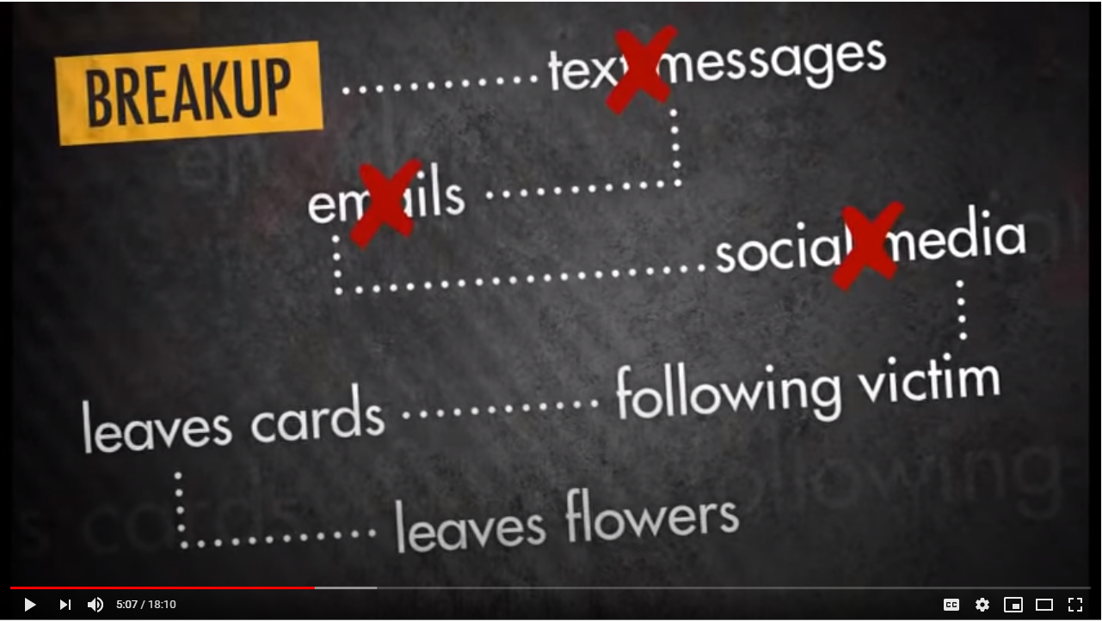
property damage/violence
Connecting the Dots: Recognizing and Responding to Stalking
http://www.evawintl.org/Library/Detail.aspx?ItemID=659
Notes:
https://youtu.be/Q2BHO8eXvxA

Slide 15
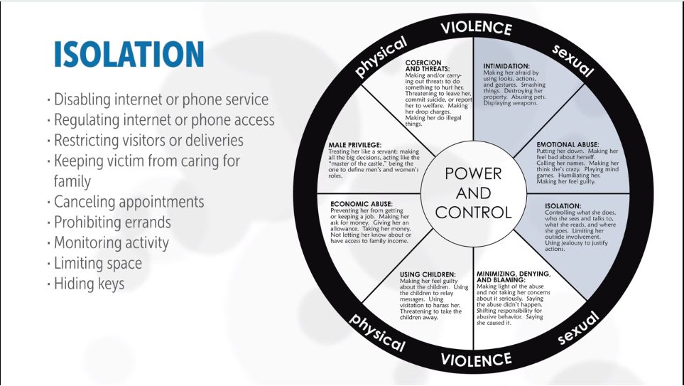
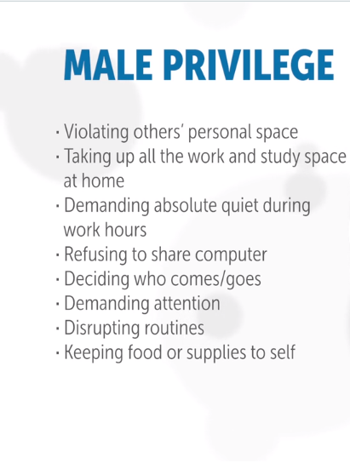
Justifying control as necessary because of the pandemic
Coercive Control during COVID-19: New Tactics
https://vimeo.com/411077713
Notes:
https://vimeo.com/411077713

Slide 16
Technology abuse – why?
Abusers disrupt the technologies that victims use.
Technology provides access to the victim (or her/his information).
It is easy for the abuser to use technology to control the victim.
Taking action to block or limit the abuser’s access to technology may drive the abuser to escalate the abusive behavior.
Safety plan
Technology safety plan

Slide 17

Technology abuse – assess the situation
What’s happening?
Does it seem like the abuser knows too much about the victim?
What technologies are being affected?
How is the abuser gaining access to the victim’s technologies?
Can the victim mitigate the situation?
Does the victim have the resources necessary?
Is the victim tech savvy enough?
Is there a current safety plan?
Can the safety plan be adapted?
How can the victim avoid family and friends compromising the safety plan?
Notes:
https://www.techsafety.org/resources-agencyuse/assessing-tech-abuse

Slide 18
the plan

Slide 19

Technology abuse – what to do?
Preserve evidence
Screenshot/record video/audio
Messages/emails/voicemails (visual)
Documents/pictures/videos
Call logs/transient evidence
Send evidence to secure repository
Print evidence
Backup everything in separate storage
Google Alerts
Document the abuse with an incident log
Record details of every abuse incident
Dates, places (tech), witnesses, evidence
Note beginning and end of behaviors
Change in frequency of behaviors
Escalation of behaviors
Actions victim has taken to mitigate the abuser’s behaviors

Slide 20
Technology abuse – sample logs
https://www.techsafety.org/documentationtips
Notes:
https://static1.squarespace.com/static/51dc541ce4b03ebab8c5c88c/t/59ea06528dd041e0d71d8b5a/1508509266850/Sample+Documentation+Log_2014.pdf
https://www.stalkingawareness.org/wp-content/uploads/2018/07/SPARC_StalkingLogInstructions_2018_FINAL.pdf

Slide 21
(or device/
account, etc.)
https://www.stalkingawareness.org/wp-content/uploads/2018/07/SPARC_StalkingLogInstructions_2018_FINAL.pdf

Slide 22
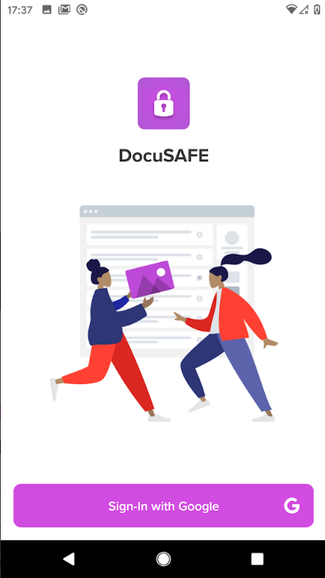
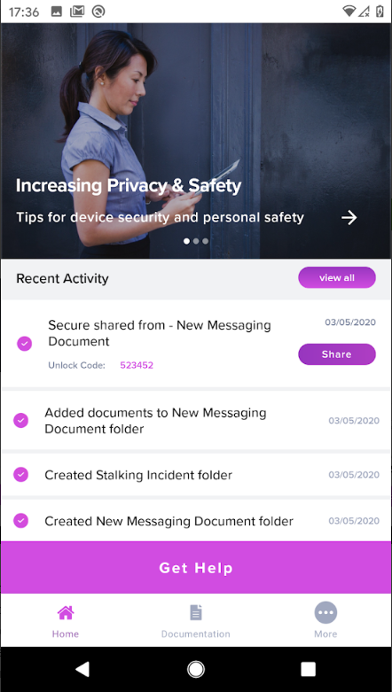
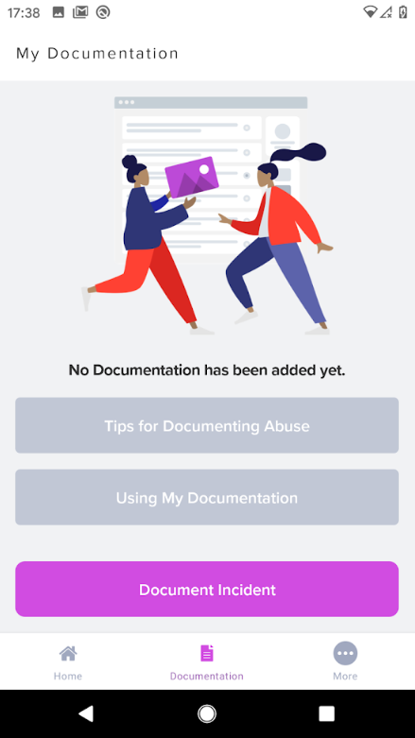
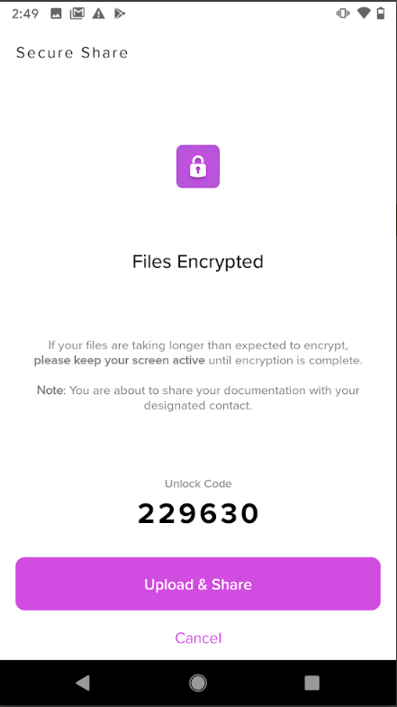
https://www.techsafety.org/docusafe
Notes:
https://www.techsafety.org/docusafe

Slide 23
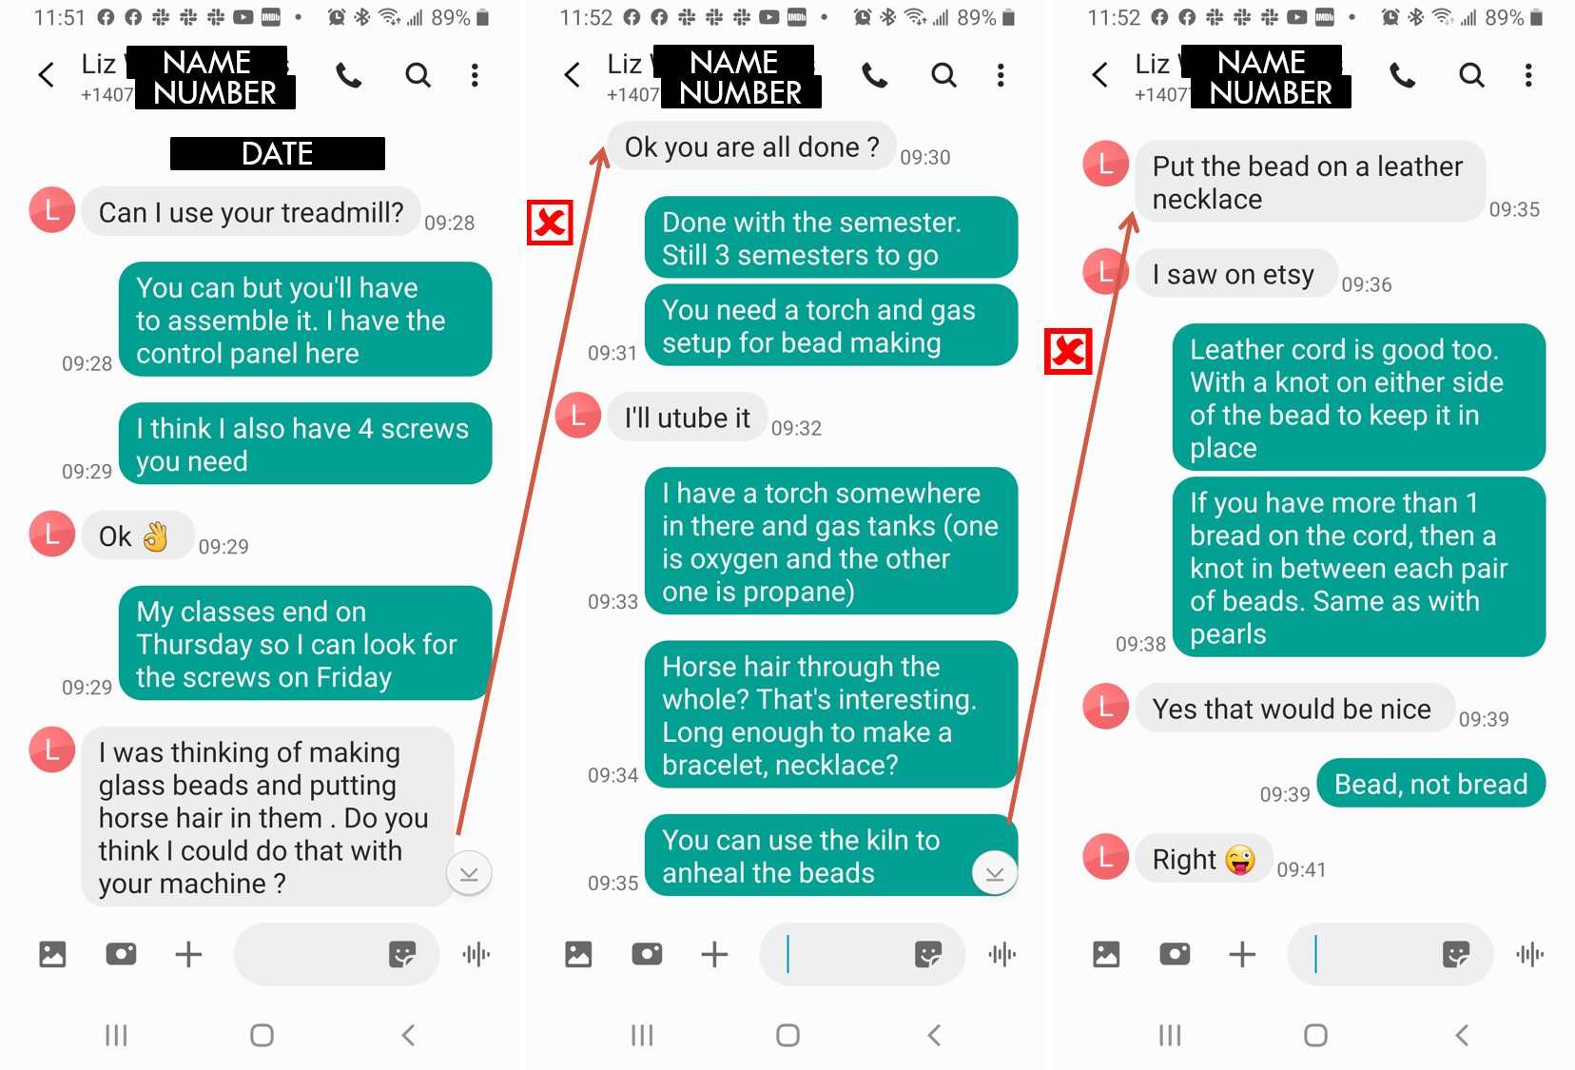

Slide 24
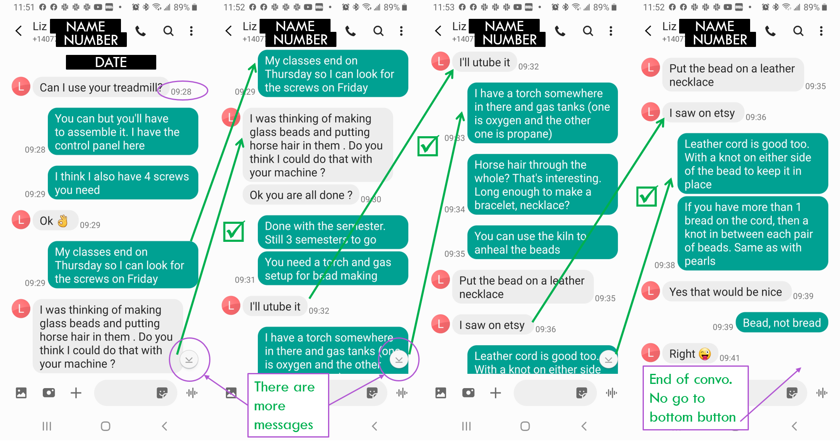

Slide 25
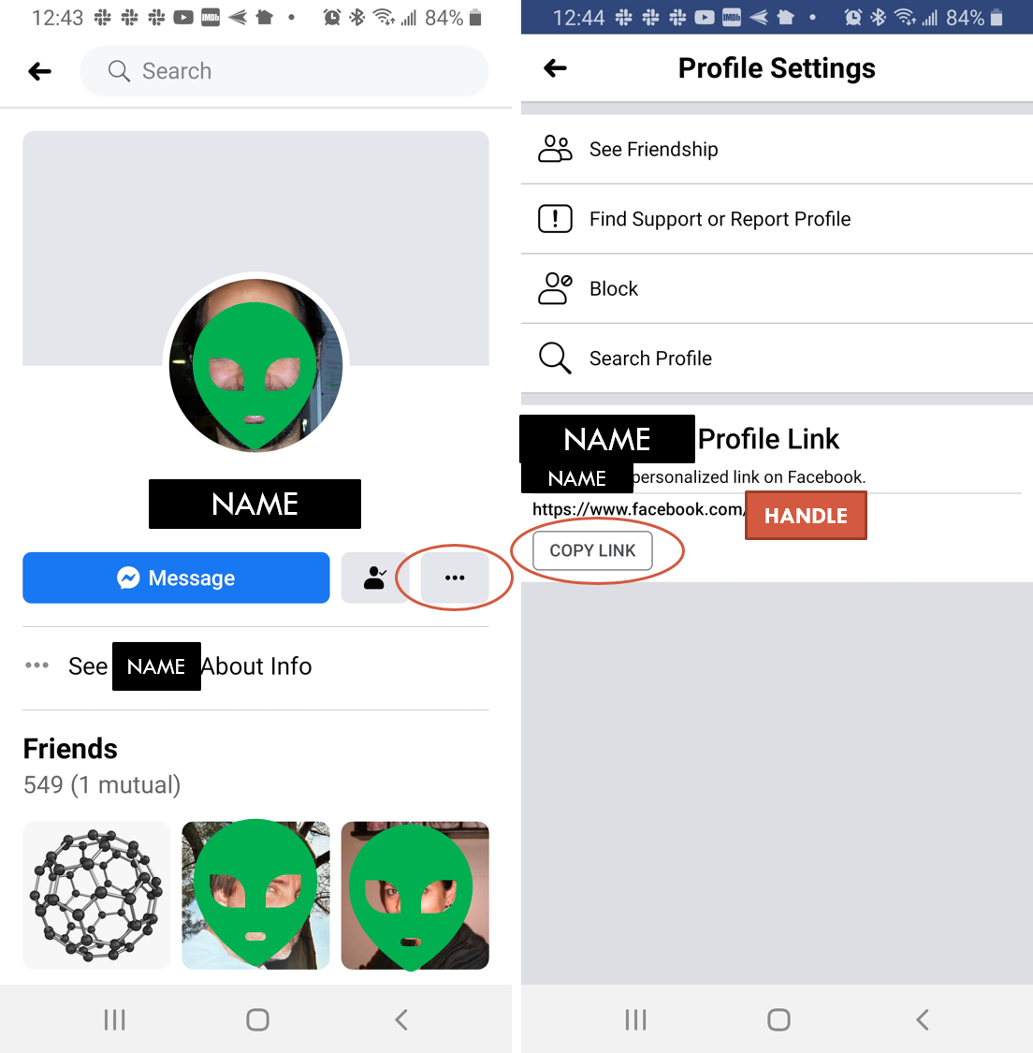

Slide 26
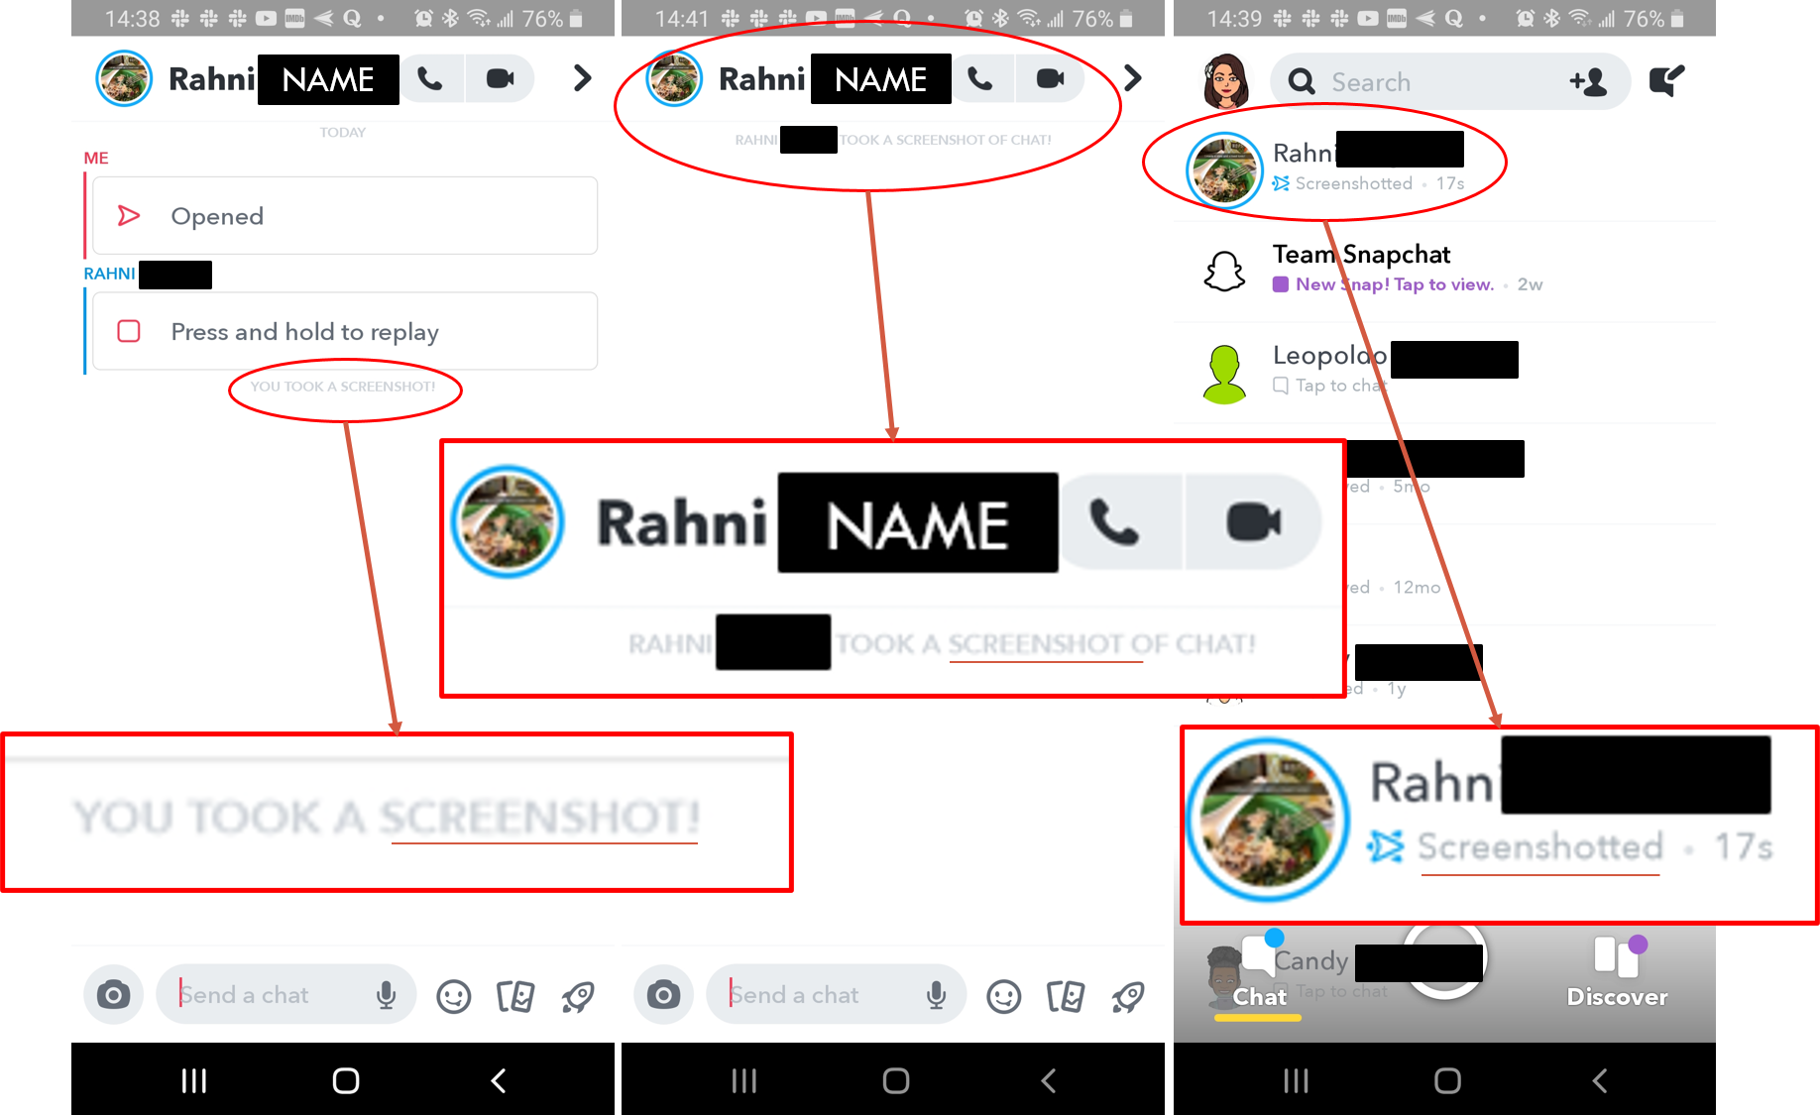

Slide 27
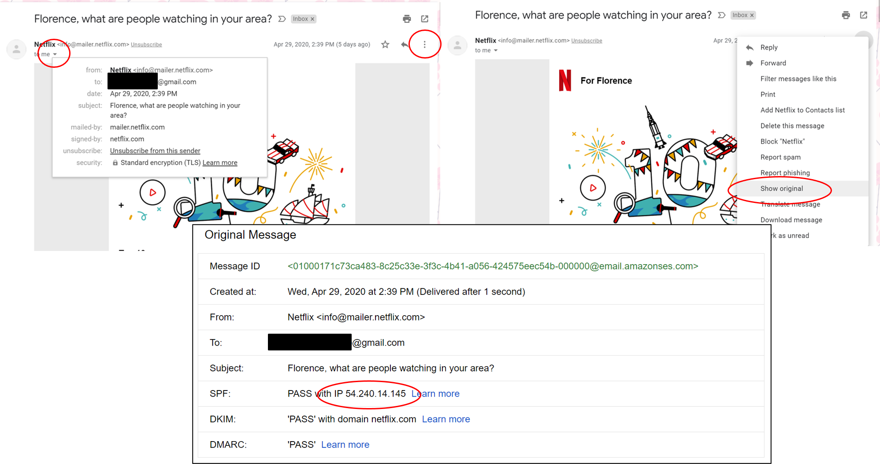
Get sender’s IP address from email header information

Slide 28
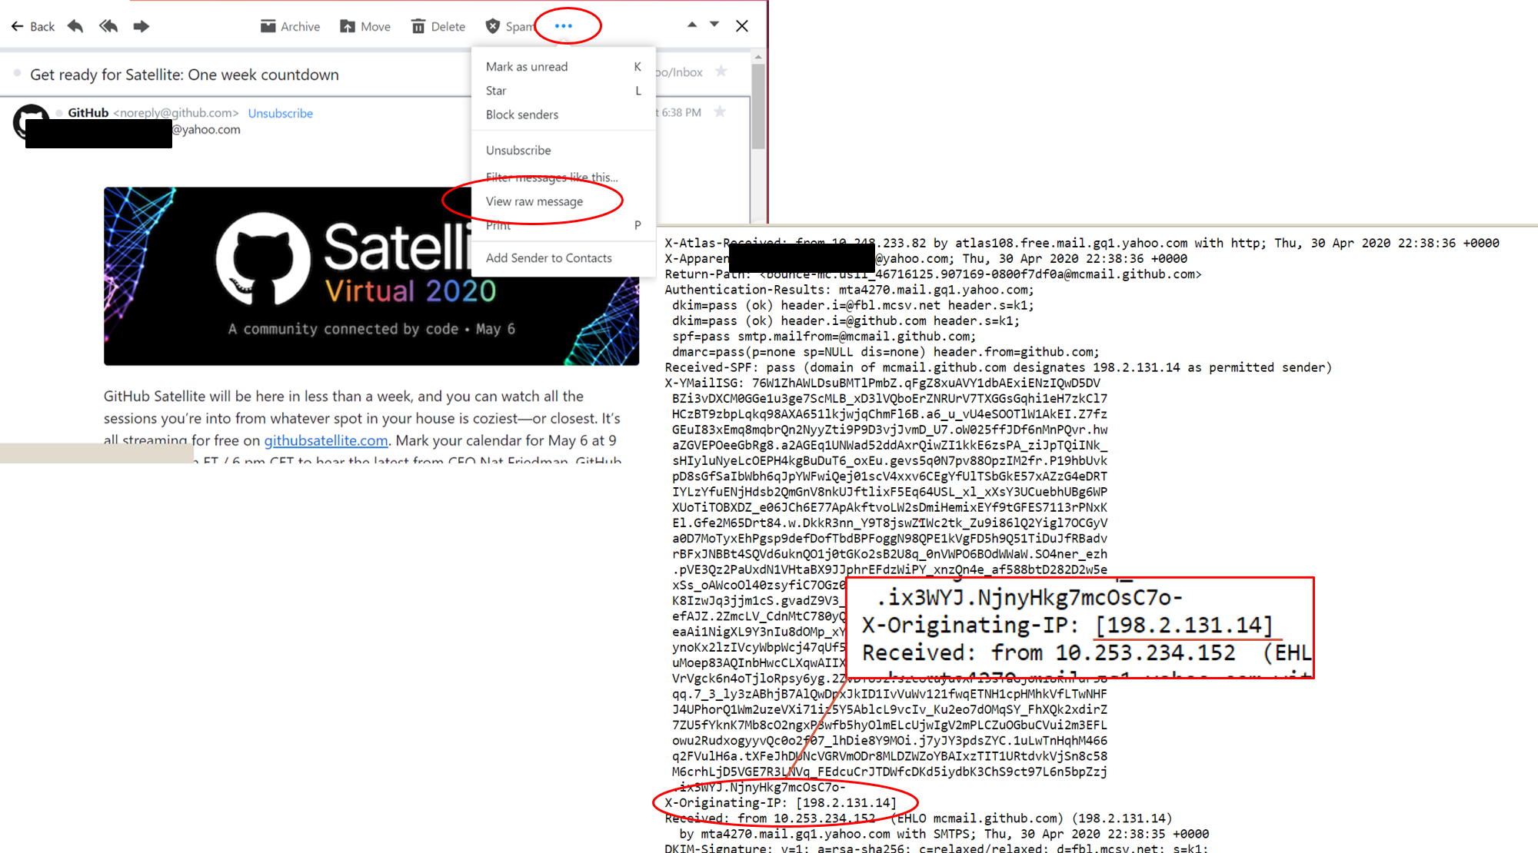

Slide 29
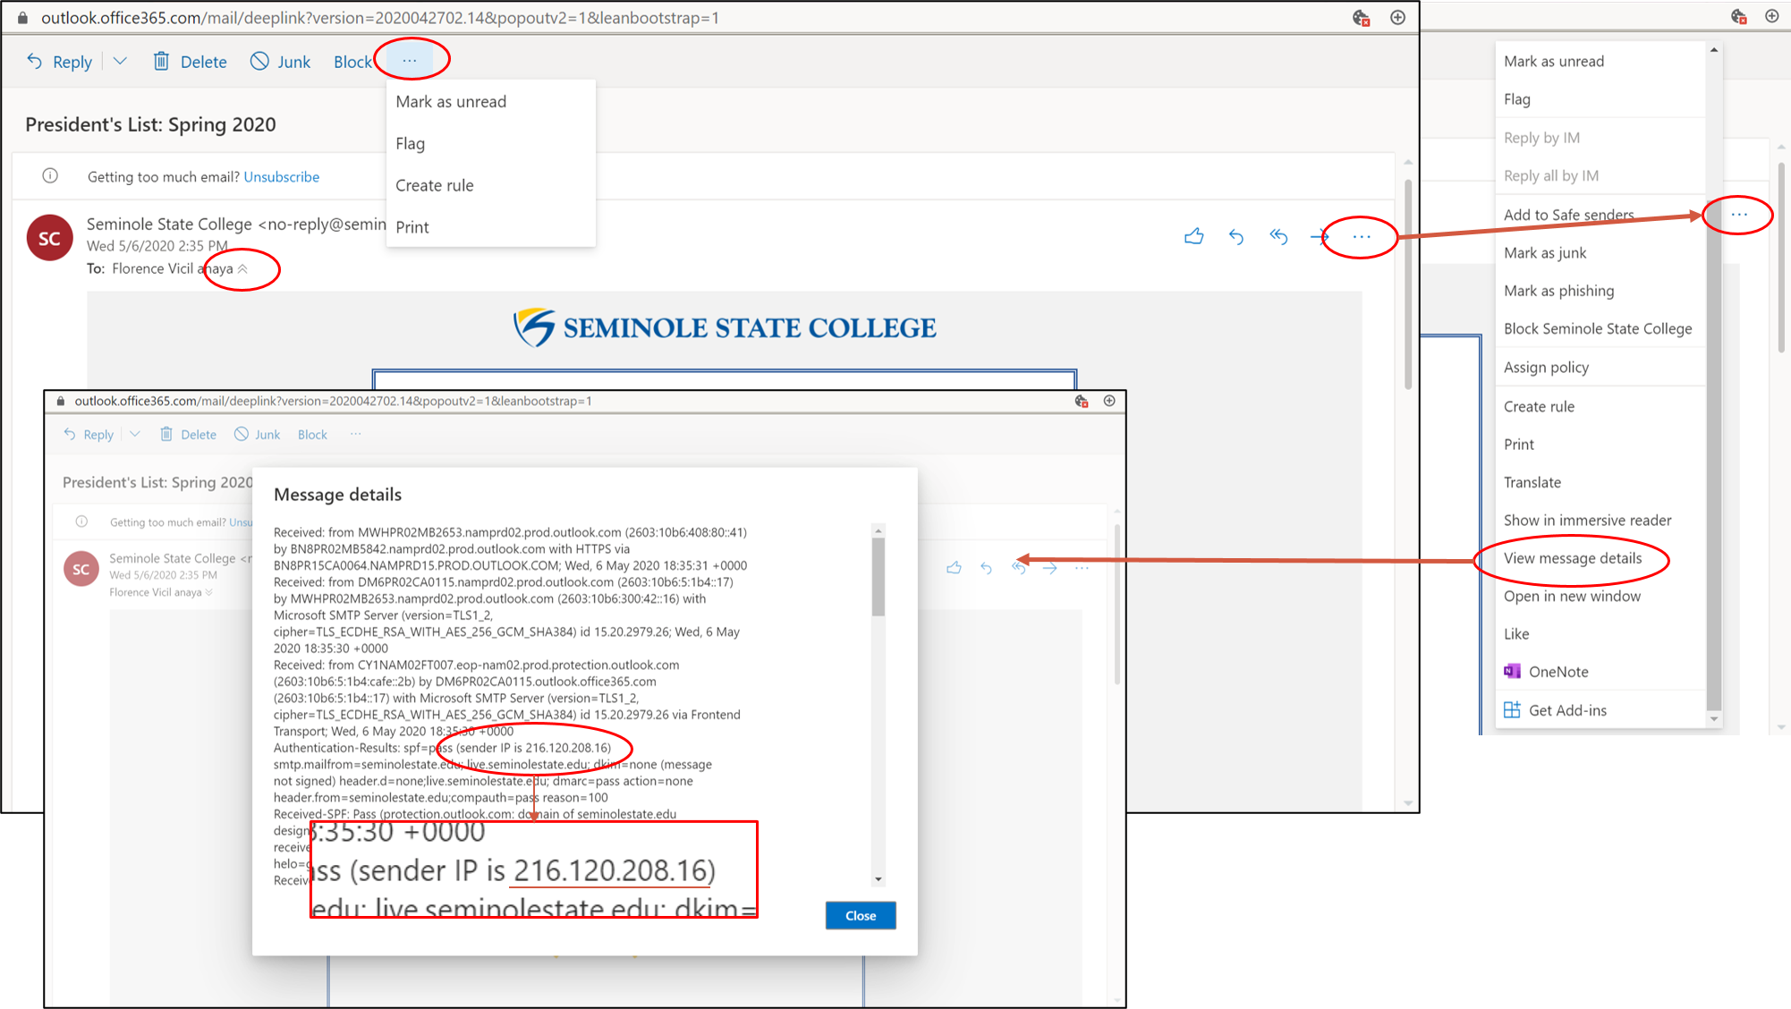

Slide 30
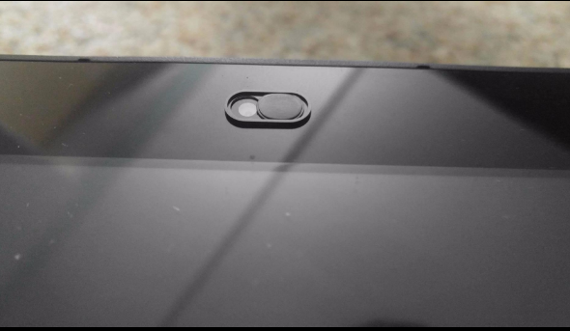

Technology abuse – what to do?
Practice digital hygiene
Decrease digital footprint
Use good password habits
Password manager
Keyloggers
Use multi-factor authentication
Use privacy settings
Always log out
Use webcam cover
Notes:
https://www.flcourts.org/Resources-Services/Court-Improvement/Family-Courts/Domestic-Violence/Library#access
https://www.flcourts.org/content/download/425826/4589773/how-to-gather-technology-abuse-evidence-for-court.pdf
https://www.mobilefun.com/olixar-anti-hack-webcam-cover-for-phones-laptops-and-tablets-3-pack-65868

Slide 31



Technology abuse – what to do?
Avoid malware
Keep software up to date
Use security software
Limit device communication/location
Disable
WiFi/Bluetooth
Peripherals/microphone
GPS location/geo-tagging of media
Metadata = data about data
Notifications
Some messages cannot be deleted
Replace or duplicate devices/accounts/log in information
Devices you trust
Devices you don’t trust
Keep old devices/accounts
To not alert abuser of the changes
To collect evidence

Slide 32
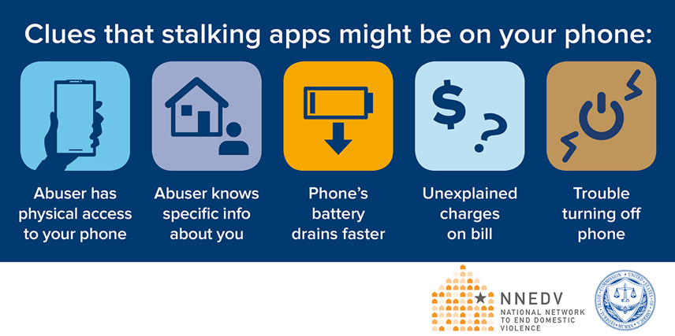
Device disappears and reappears
Increase in data usage
Unusual phone behavior
http://www.stopstalkerware.org/
Notes:
https://www.techsafety.org/blog/2019/11/18/making-strides-to-stop-stalkerware

Slide 33
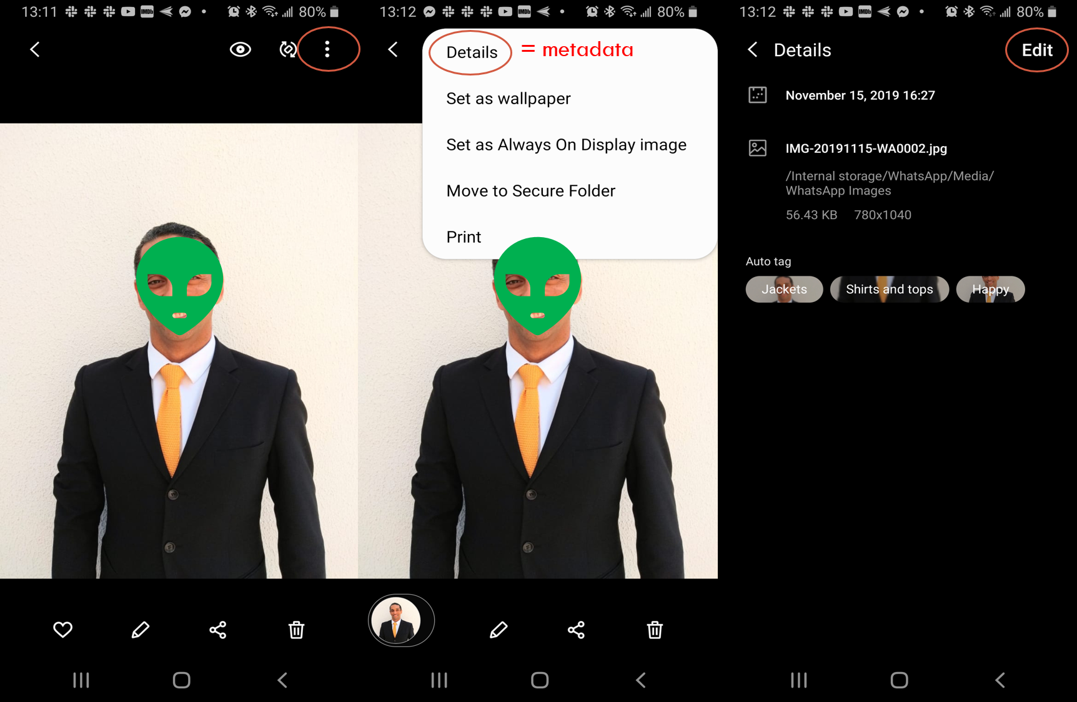

Slide 34
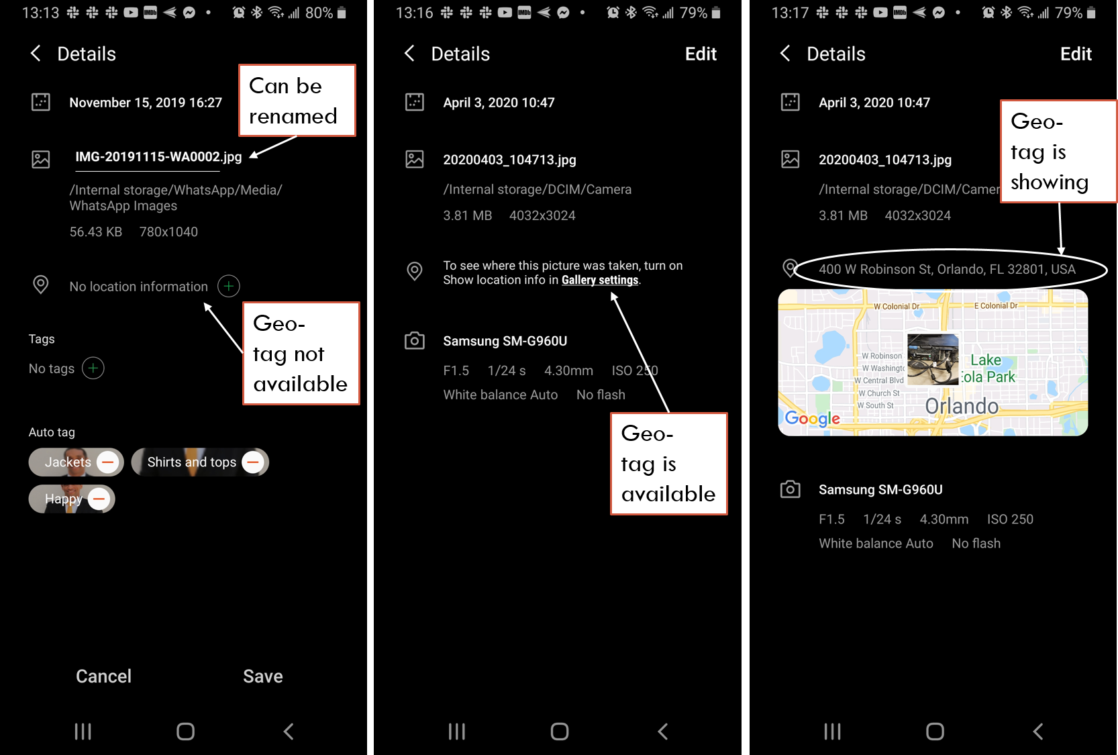

Slide 35
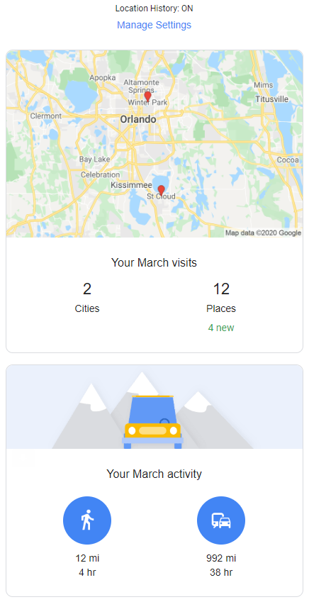
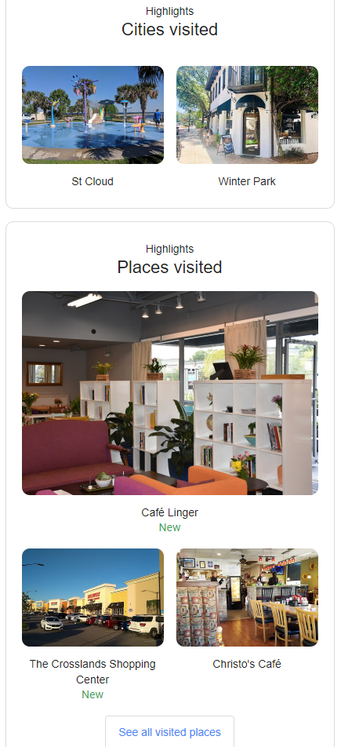
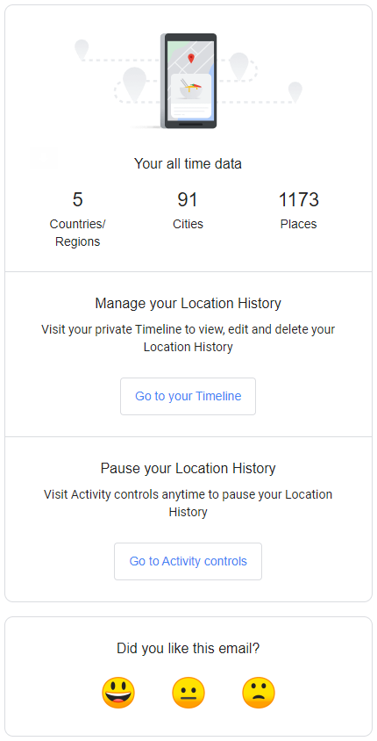
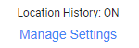
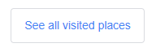

Slide 36
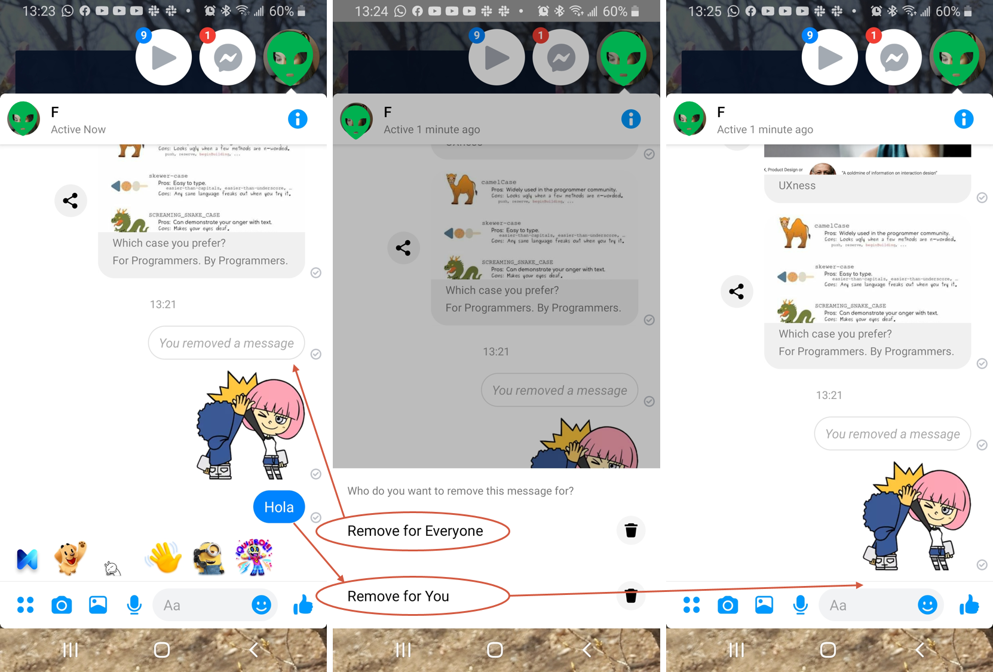

Slide 37
Technology abuse – what to do?
Restrict access to your information
Freeze credit/accounts
https://www.annualcreditreport.com
http://www.nctue.com/
https://www.innovis.com/
https://www.chexsystems.com/
Florida Attorney General’s Address Confidentiality Program
http://www.fcpti.com/fcpti.nsf/pages/AddressConfidentialityProgram
Request family violence indicators be placed on records to trigger nondisclosure
§61.1825(3)(a) State Case Registry
Request exemption from public records
§119.071(2)(j)1 General exemptions from inspection or copying of public records
Notes:
https://static1.squarespace.com/static/51dc541ce4b03ebab8c5c88c/t/5a611cfa53450a0bfbecff8b/1516313850795/ACP+Chart+Sept+2016_Final.pdf
http://www.leg.state.fl.us/statutes/index.cfm?App_mode=Display_Statute&Search_String=119.07&URL=0100-0199/0119/Sections/0119.071.html
http://www.leg.state.fl.us/statutes/index.cfm?mode=View%20Statutes&SubMenu=1&App_mode=Display_Statute&Search_String=61.1825&URL=0000-0099/0061/Sections/0061.1825.html

Slide 38
Technology abuse – what to do?
Limit the information you share
Do not share accounts with the abuser
Opt out of data collection (third-party tracking)
Disable password saving in browsers/apps
Do not share contact lists to see if your contacts are using the same service/network
Make online profiles non-searchable
Report the abuse
Local law enforcement
Florida Computer Crime Center
https://www.fdle.state.fl.us/FCCC
FBI Internet Crime Complaint Center
https://www.ic3.gov/
Website/platform flags
Notes:
https://static1.squarespace.com/static/51dc541ce4b03ebab8c5c88c/t/5a611cfa53450a0bfbecff8b/1516313850795/ACP+Chart+Sept+2016_Final.pdf
http://www.leg.state.fl.us/statutes/index.cfm?App_mode=Display_Statute&Search_String=119.07&URL=0100-0199/0119/Sections/0119.071.html
http://www.leg.state.fl.us/statutes/index.cfm?mode=View%20Statutes&SubMenu=1&App_mode=Display_Statute&Search_String=61.1825&URL=0000-0099/0061/Sections/0061.1825.html

Slide 39
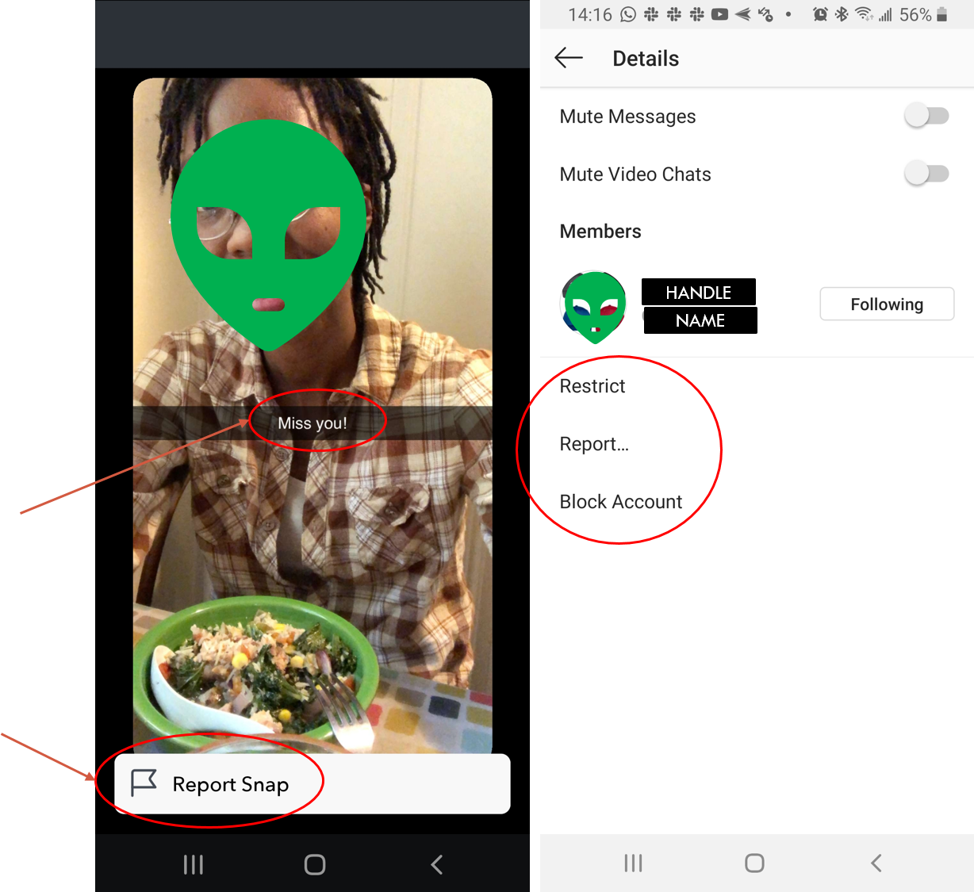
Restricting the abuser’s access to your content restricts your access to their content.
Restricting the abuser’s access to your content restricts your access to their content.
Harassing message
Creates electronic paper trail of incident

Slide 40
Technology abuse – what to do?
Seek legal protection
No contact orders
Injunctions
In person
https://www.myorangeclerk.com/Divisions/Family/Restraining-Orders
Florida Courts E-Filing Portal
https://www.myflcourtaccess.com/
Pressing charges
Legal Aid
https://www.flcourts.org/Resources-Services/Court-Improvement/Family-Courts/Family-Law-Self-Help-Information/Legal-Aid
Evidence based prosecution

Slide 41
Technology abuse – what to do?
Educate children, family, and friends
I am Cyber Safe
https://www.iamcybersafe.org/
Family Online Safety Institute
https://www.fosi.org/
Online Safety for Kids & Families
https://www.missingkids.org/NetSmartz
Facebook’s Digital Literacy Library
https://www.facebook.com/safety/educators
Safe Online Surfing (SOS) - FBI
https://sos.fbi.gov/en/
STOP. THINK. CONNECT. Toolkit - CISA
https://www.cisa.gov/stopthinkconnect-toolkit
Notes:
https://static1.squarespace.com/static/51dc541ce4b03ebab8c5c88c/t/5e8e0ed3bcc74033b670a8d0/1586368212209/NNEDV+COVID+Tips+FINAL.pdf

Slide 42
resources

Slide 43
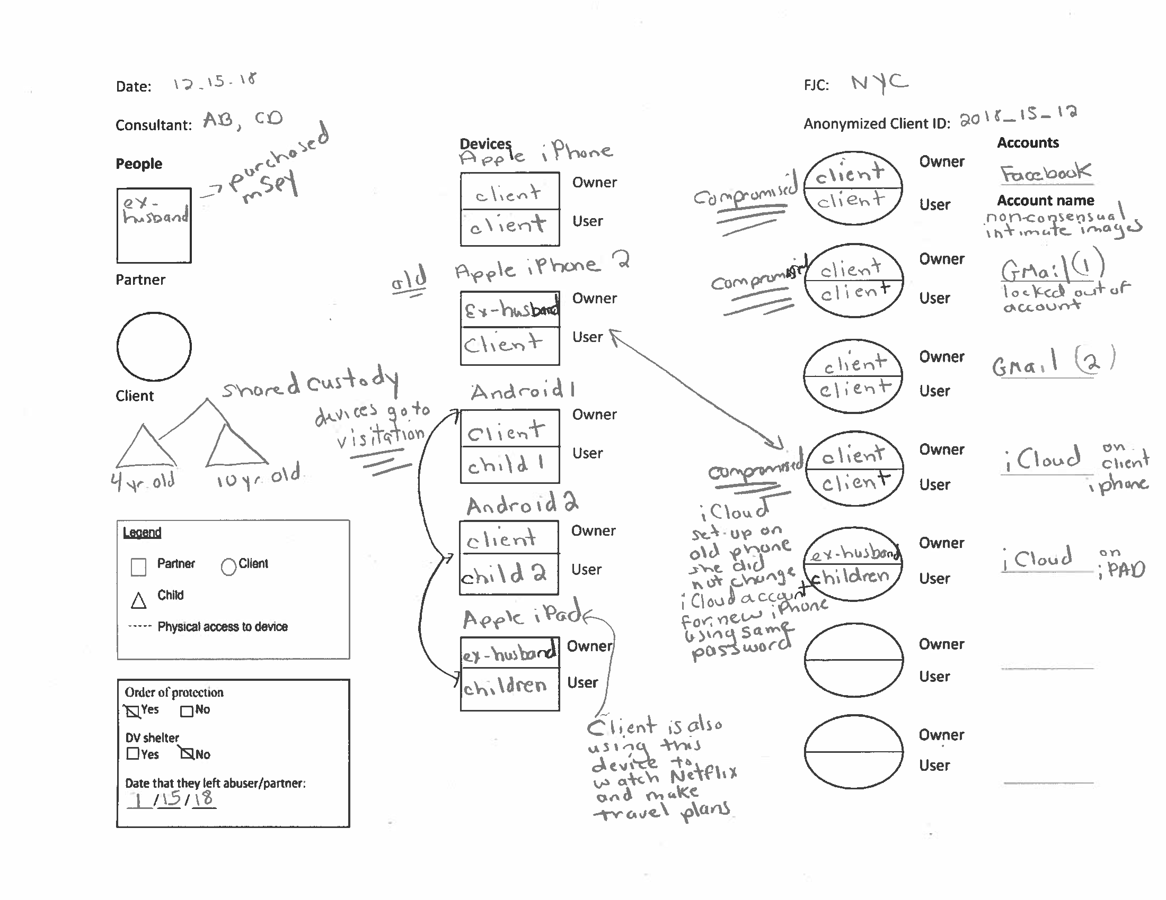
Computer Security and Privacy for Survivors of Intimate Partner Violence
https://www.ipvtechresearch.org/resources
Technology Assessment Questionnaire (TAQ)
Privacy Checkup Guides
IPV Spyware Discovery Tool (ISDi)
Technograph
App Classification Guide
Notes:
http://www.nixdell.com/papers/2019-usenix_clinical_security_FULL.pdf
https://news.cornell.edu/stories/2019/08/new-tools-help-detect-digital-domestic-abuse
https://techcrunch.com/2019/08/15/toolkit-for-digital-abuse-could-help-victims-protect-themselves/

Slide 44

National Network to End Domestic Violence
https://www.techsafety.org/
Survivor Toolkit
App Safety Center
Agency Use toolkit
Digital Services Toolkit
Confidentiality Toolkit
Legal Systems Toolkit
Judicial Toolkit

Slide 45

Phone Apps and features
https://techsafetyapp.org/
https://www.circleof6app.com/
https://kineticglobal.com/
https://getbsafe.com/
https://www.myplanapp.org/
SOS feature
Android
iOS
Any phone will call 911 regardless of service subscription status
Notes:
https://www.colorado.edu/today/2018/12/05/sos-tips-utilizing-your-smartphone-emergency

Slide 46
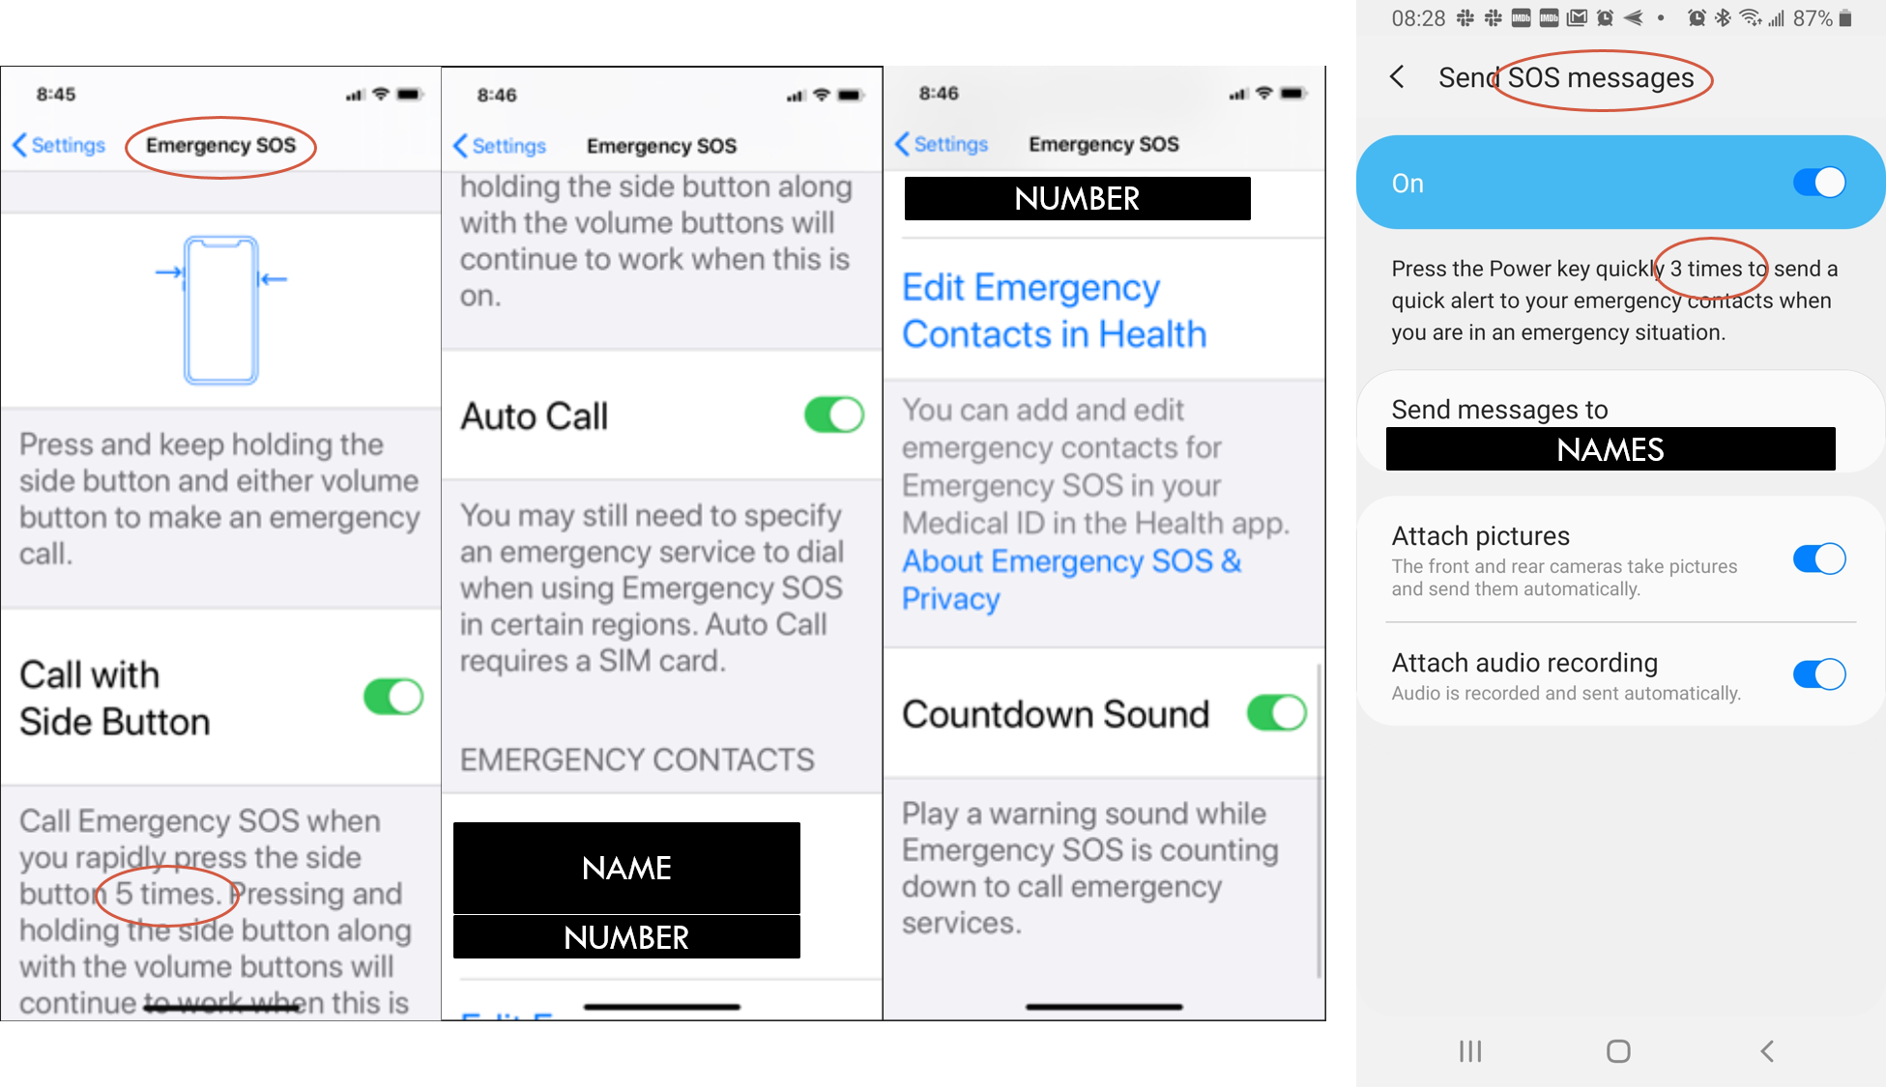

Slide 47
Other resources
How to Gather Technology Abuse Evidence for Court
https://www.flcourts.org/content/download/425826/4589773/how-to-gather-technology-abuse-evidence-for-court.pdf
DIY Cybersecurity for Domestic Violence
https://hackblossom.org/domestic-violence/
Stalking online training from the National Center for Victims of Crime
http://www.tech2stalk.com/
Tech and safety online course from the Florida Coalition Against Domestic Violence
https://domesticviolencetraining.fcadv.org/

Slide 48
Other resources
Cyber Civil Rights Initiative (End Revenge Porn)
https://www.cybercivilrights.org/
Gender and IoT (G-IoT) Resource List
https://www.ucl.ac.uk/steapp/sites/steapp/files/g-iot-resource-list.pdf
Electronic Privacy Information Center
https://epic.org/
Facebook’s Safety Center
https://www.facebook.com/safety/resources
Connect Safely
https://www.connectsafely.org/
Media Smart
https://mediasmarts.ca/
Notes:
https://static1.squarespace.com/static/51dc541ce4b03ebab8c5c88c/t/5ea32c03aa6eb676ab00ab1f/1587751939992/NNEDV_Seeking+Help+Online_2020.pdf

Slide 49

Other resources
Digital abuse article series
https://www.thehotline.org/category/behind-the-screens/
Social Media Security & Privacy Checklists – New York Times
https://docs.google.com/document/d/1ud1ILFkIG0BeLX9jlzJMxCPm8-cSeqPjU60nkhUPYA8/edit

Slide 50

THANK YOU!

